Slide 1
PROFILE
TAZKIA CONSULTING

Slide 2

About us
history
PT TAZKIA FINANSIAL SEJAHTERA (TAZKIA Consulting) is a firm established in 1998 originally named PT Tazkia Inti Wahana (TAZKIA INSTITUTE). In 2004, as a result of merger between PT Tazkia Inti Wahana and Batasa Consulting of PT BATASA Capital, the new entity BATASA TAZKIA Consulting was founded. And Branding is Tazkia Consulting
TAZKIA Consulting has over ten years of experience in islamic banking, insurance, capital market and finance, with the combined experience of its consultants reaching almost 40 years.
TAZKIA was the pioneer in Islamic Finance Consultancy and Training. BATASA TAZKIA has been involved with and assisted virtually all Islamic banks in the country.

Slide 3

About us
vision
To become a reliable provider of Islamic business and finance solutions as well as professional training and development for businesses and entities that seek to adhere to shariah principles

Slide 4

About us
mission
To provide dependable solutions that becomes a benchmark for business and financial consulting services as well as competency training and development
To be the primary source in providing strategy and course of action, as well as in developing and promoting Islamic finance
To provide the best possible return for the stakeholders

Slide 5
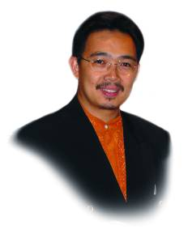
Our team
senior management
PRINCIPALS
MUHAMMAD SYAFII ANTONIO - Chairman
Has over 21 years of experience in Islamic Banking and renowned expert in Islamic economics and finance. He holds Ph.D in Finance from University of Melbourne, obtained Masters of Economic from International Islamic University Malaysia and first degree in Islamic Law from University of Jordan and Islamic Studies Program from Al Azhar University Cairo. He has published twelve books on leadership, Islamic banking, Islamic economics, and zakat. Currently serves as Shariah Advisor in several Islamic financial institutions locally and abroad, as well as member of the National Economic Committee (KEN) and National Shariah Council.

Slide 6
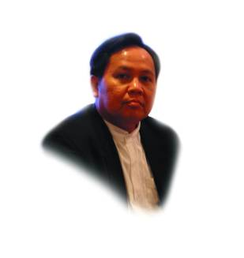
Our team
senior management
Director
DUDDY YUSTIADI
Has over 14 years of experience as Senior Executive at Bank Muamalat Indonesia before joining Tazkia Institute in 1999. Currently he is Director of BATASA TAZKIA Consulting since 2004. With specialization in financing, profit distribution and services, he has been a lead consultant in many projects, mostly in Islamic Banking conversion and training. He is active as a lecturer and instructor in many program and training in Islamic Banking.

Slide 7
Our team
consultants & expertise
Partners/Senior Consultants | Expertise
Mukhamad Yasid, Dr | iB → Strategic Planning, Balance Scorecard, Corporate Plan, Business Plan, Feasibility Study
Rukmana | iB → Financing, Product Development, Legal issues for iB, Strategic Planning, Business Plan
Prana Tanjudin, SH | iB → Financing, Product Development, Legal issues for iB
Ir. Agus Haryadi, FIIS | Islamic Insurance → Strategic Planning, Actuary, Shariah issues
Muhammad Gunawan Yasni | Islamic Capital Market → Sukuk, Fund Management, Shariah issues
Luqyan Tamanni, M.Ec | iB → Strategic Planning, Corporate Plan, Business Plan, Research & Feasibility Study

Slide 8
Our team
consultants & expertise
Consultants | Expertise
Amin Musa, SE, FIIS | PSAK, Accounting, Product development, Compliance
Eka Shanty | Corporate Communications
Muhammad Zamachsyari, FIIS | Islamic Insurance → Product, IT/System
Salman Taufik | iB → Risk Management
Wiroso | iB → Accounting, Legal
Eko Dedi Rukminto | iB → Financing, IT, Product Development
Najimuddin | iB → System, Manual/SOP
Tutut Handayani | HR Development, HR Assessment
Rahmat Mulyana | iB Finance → Risk Management
Muhammad Rezqi Yuwono | iB, Islamic Insurance → Product Development
Kahfi Riza | iB → SOP, Marcom, Branding

Slide 9
Our services
our propositions
Solutions Driven
Internal Strength
Strategic Partners
CLIENTS
Batasa Tazkia strives to add value to the client’s business by providing complete solutions to meet their growing needs & ambitions.
Client-driven solutions and consultancy
Batasa Tazkia strength as pioneer in key services, ie. spin-off, and leading provider of shariah consultancy and trainings
Supported by partners who are leader in their respective field; islamic business, Islamic finance, corporate strategy, corporate finance, corporate communications, HR Development

Slide 10
Our services
our focus: solutions
Client Needs
Corporate/Strategic Solutions
Operations Solutions
Product
& Growth Solutions
Corporate & Personal Finance Solutions
HR Solutions
Client’s needs are our main concern.
With more than 11 years of experiences in the market and dedicated consultant team, we strive to work on solutions to meet the needs of our client.

Slide 11
Our services
our focus: solutions
Product Development
Financial Planning
Corporate Finance
Training & Recruitment
Operations
SOLUTIONS
Islamic Business Set-up

Slide 12
Our services
our core products
Training & recruitment
Basic iB/PDPS
HR Mapping & Assessment
Business Operations
SOP-Manual
Spin off/M&A Analysis
Business Set-up
Spin-off
Skill: AO, Legal, Funding, Marketing
Recruitment
Feasibility study
Corp. plan
Business plan
Shariah Unit/UUS set-up
Shariah business/BUS set-up
Islamic Wealth Management
Training and education
Wealth Management
Non-iB Training: Takaful, Sukuk, Mutual funds
Conversion
Waqf-Zakat Management
Product development
Warits-Faraidl Consultancy
Corporate values

Slide 13
Our portfolio & experience
top clients portfolio
Partner | Assistance and Services | Year
PT. Bank BJB Tbk. | Spin off & establishment of BJB Syariah | 2008
 | Standard operating procedure (SOP) | 2006
 | SOP & legal drafting of ‘aqad/contracts | 2003
 | Advise on the organizational structure | 2002
 | Establishment of shariah unit/UUS & shariah branchless | 2000
PT. Bank BPD Kaltim | Standard operating procedure (SOP) | 2006
 | SOP & legal drafting of ‘aqad/contracts | 2006
 | Advise on the organizational structure | 2007
 | Establishment of shariah unit/UUS & shariah branchless | 2007

Slide 14
Our portfolio & experience
portfolio – operations improvement
Operations Solutions | Clients
Develop & Implementations Support
Business Plan, Blue print & Road Map | Bank Jateng, Bank Ekspor Indonesia, Bank Kaltim, Bank BRISyariah, Bank BTN, Bank Sumut, Bank BII, Bank Jatim Syariah
Corporate Plan | Bank BRI, Bank BJB
SOP | Bank BPD Sumselbabel, Bank BPD Jateng, Bank BPD Kaltim, Bank BRI, Bank BTN, Bank Sumut, BPD Aceh, Bank BII, Bank Danamon, Bank BJB, Bank Syariah Bukopin, Bank Syariah Mandiri
Feasibility Study | Bank Jateng, Bank BJB, Bank Aceh, Bank Sumut, Bank Kaltim, Bank Maluku, Bank BTN, Asuransi Tugu Pratama Indonesia
Legal Drafting/’Aqad | Bank Jateng, Bank Kaltim, Bank BTN, Bank Sumut, Bank BPD Aceh, Bank BII, Bank Danamon

Slide 15
Our portfolio & experience
portfolio – HR solutions
HR Solutions | Clients
Recruitment | Bank BPD Jateng, Bank BPD Kaltim, Bank BRI, Bank BTN, Bank Sumut, BPD Aceh, Bank BII, Bank Danamon, Bank BJB, Bank Syariah Bukopin, Bank Syariah Mandiri
Training – Islamic banking | Bank Indonesia, BNI Syariah, Bank Sumut
Basic | Bank BPD Jateng, Bank BPD Kaltim, Bank BRI, Bank BTN, Bank Sumut, BPD Aceh, Bank BII, Bank Danamon, Bank BJB, Bank Syariah Bukopin, Bank Syariah Mandiri
AO | Bank BPD Kaltim
Legal | Bank BJB Syariah
Officer Development Program | Bank BJB Syariah, Bank BNI Syariah
Training – Insurance | Sunlife

Slide 16



Our portfolio & experience
iB – business transformation
Spin-Off/Transformation of Shariah Banking Unit/UUS, Bank Jabar Banten into Bank BJB Syariah → 2008 – 2009
Transformation of Shariah Banking Unit/UUS, PT. Bank BRI Tbk. into Bank BRI Syariah through acquisition and conversion of Bank Jasa Artha → 2006 – 2007
Transformation/full conversion of Bank Susila Bhakti (BSB) to Bank Syariah Mandiri (BSM) → 1999

Slide 17


Our portfolio & experience
Islamic financial institution – pleminiary study
Preliminary Study - Sharia’ Business Unit of Bank Tabungan Negara → 2011
Preliminary Study - Sharia’ Business Unit of Tugu Pratama Indonesia Insurance → 2011

Slide 18









Our portfolio & experience
iB – Est. of shariah unit
Establishment of Shariah Unit (UUS) of Bank Bukopin, 2000
Establishment of Shariah Unit (UUS) of Bank Jabar, 2000
Establishment of Shariah Unit (UUS) of Bank Danamon Indonesia, 2002
Establishment of Shariah Unit (UUS) of Bank BII, 2003
Establishment of Shariah Unit (UUS) of Bank BPD Aceh, 2003-2004
Establishment of Shariah Unit (UUS) of Bank Sumut, 2004
Establishment of Shariah Unit (UUS) of Bank BTN, 2004-2005
Establishment of Shariah Unit (UUS) of Bank BPD Kaltim, 2006
Establishment of Shariah Unit (UUS) of Bank Ekspor Indonesia, 2006-2007
Establishment of Shariah Unit (UUS) of Bank BPD Jateng, 2007
Establishment of Shariah Unit (UUS) of Bank OCBC NISP, 2009

Slide 19







Our portfolio & experience
non-bank – Est. of shariah unit
Establishment Shariah Branch at Asuransi Panin Life Tbk.
Establishment Shariah Branch at Asuransi Ramayana
Establishment Shariah Branch at Asuransi Wana Artha
Establishment Sharia Custodian Bank at Citigroup
Establishment Shariah Multi Finance at Bhakti Finance
Establishment Shariah Multi Finance at KITA Finance
Establishment Shariah Business Unit at Koptel

Slide 20




Our portfolio & experience
in SOP & product development
Product Development at Bank Syariah Mandiri
SOP Development at Bank Bukopin Syariah
SOP Development at Bank Jabar Syariah
SOP Development at Bank Danamon Syariah
SOP Development at BII Syariah
SOP Development at Bank BPD Aceh Syariah
SOP Development at Bank Sumut Syariah

Slide 21





Our portfolio & experience
in SOP & product development
SOP Development at Bank BTN Syariah
SOP Development at (Revise) Bank Jabar Syariah, 2006
SOP Development at Bank BPD Kaltim Syariah, 2007
SOP Development at Bank BPD Jateng Syariah, 2007
SOP Development at Bank BRI Syariah, 2007
SOP Development at Bank Sumsel Babel
SOP Development at Bank Kalbar

Slide 22






Our portfolio & experience
HR – organization & recruitment
Organization Structure Development Assistancy at Bank Syariah Mandiri
Organization Structure Development at Bank Jabar Syariah, 2002
Organization Structure Development at Bank Danamon Syariah, 2002
Organization Structure Development at Bank BTN Syariah, 2004
Recruitment & HR Assessment of UUS & KCS of BTN Syariah:
For 2004, 2005, 2006, 2007 and Total recruitment for 16 branches
Organization Structure Development of Bank BPD Kaltim Syariah, 2006
Recruitment & HR Assessment of US and KCS of BPD Kaltim Syariah
2006, 2007, 2008, 2009, 2010
Organization Structure Development & HR Assessment of Bank Jateng, 2007
Recruitment & HR Assessment of BPD Kalsel, 2009

Slide 23








Our portfolio & experience
advisory – IT/core banking for iB
IT Development Assistancy Bank Syariah Mandiri - Sigma
IT Development Assistancy Bank Jabar – Tera Data
IT Development Assistancy Bank Danamon Syariah - Sigma
IT Development Assistancy Bank BII Syariah - Sigma
IT Development Assistancy Bank BPD Aceh Syariah - Collega
IT Development Assistancy Bank Sumut Syariah - Collega
IT Development Assistancy Bank BTN Syariah – Sigma
IT Development Assistancy Bank BPD Kaltim Syariah – Sigma
IT Development Assistancy Bank Jateng Syariah - Sigma

Slide 24




Our portfolio & experience
training - iB
Islamic Banking Training at Bank Indonesia 25 Batches
Islamic Banking Training at Bank Syariah Mandiri (d/h BSB) 32 Batches
Islamic Banking Training at Bank Danamon Syariah 8 Batches
Islamic Banking Training at Bank Jabar Syariah 4 Batches
Islamic Banking Training at Bank DUTA 2 Batches
Islamic Banking Training at Bank BBD 2 Batches
Islamic Banking Training at Bank BII 2 Batches
Islamic Banking Training at Bank BPD Aceh 2 Batches
Islamic Banking Training at Bank Bukopin
Islamic Banking Training at Bank BNI
Islamic Banking Training at OCBC NISP

Slide 25








Our portfolio & experience
training - iB
Islamic Banking Training at Bank Tugu
Islamic Banking Training at Bank BTN 10 Batches
Islamic Banking Training at Bank BTN 3 Batches
Islamic Banking Training at BRI Syariah 2 Batches
Islamic Banking Training at Permodalan Nasional Madani 5 Batches
Islamic Banking at Bank Sumut Syariah 3 Batches
Islamic Banking Training at Bank Century
Islamic Banking Training at Bank Niaga Syariah
Islamic Banking Training at Bank BPD Kaltim Syariah 2 Batches
Islamic Banking Training at Bank Ekspor Indonesia
Islamic Banking Legal Aspect Traning at ABNR Law Firm
Islamic Banking Training at Bank BPD Jateng
Islamic Banking Training at Bank Kalbar

Slide 26





Our portfolio & experience
training – islamic insurance

Slide 27











Our portfolio & experience
training – islamic capital market
Bhakti Investama

Slide 28
Our portfolio & experience
HR development – iB ODP
Officer Development Programme for Bank Jabar for 30 Days
Officer Development Programme for Bank BNI for 55 Days

Slide 29

Our portfolio & experience
study – iB industry analysis
Preparation of Feasibility Study of Islamic Banking Industry for Market Entry in Indonesia for Kuwait Finance House (PWC’s client) in 2005, and updating in 2007.

Slide 30

Our portfolio & experience
corporate value
Preparation of Kalla Group Corporate Values aimed at improving the staff’s sense of togetherness, integrity and pride as member of the group. The document will be used as a manual to strengthen corporate identity The assignment also include preparation of a management book plus a field book. This book and its accompanying field book is similar to ‘The Toyota Way’.

Slide 31
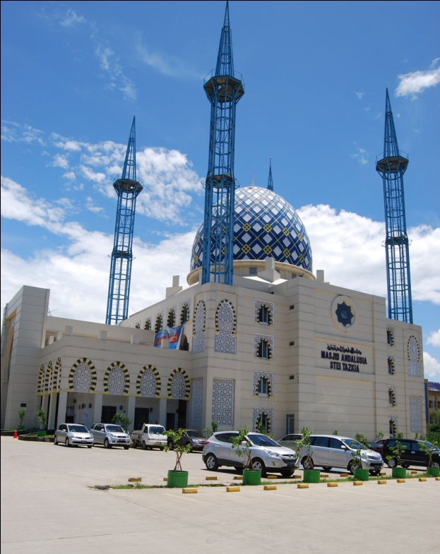
Contact us
PT. Tazkia Finansial Sejahtera
GEDUNG UTAMA TAZKIA
Jl. Ir. H. Juanda No. 78, Sentul City, Bogor 16810, Indonesia
Phone :+62 21 87962691, 87962692
Fax :+62 21 87962690

